Slide 1

APPLICATION SECURITY

Slide 2

Application Security
Application security is the use of software, hardware, and procedural methods to protect applications from external threats.
Once an afterthought in software design, security is becoming an increasingly important concern during development as applications become more frequently accessible over networks and are, as a result, vulnerable to a wide variety of threats.
Security measures built into applications and a sound application security routine minimize the likelihood that unauthorized code will be able to manipulate applications to access, steal, modify, or delete sensitive data

Slide 3
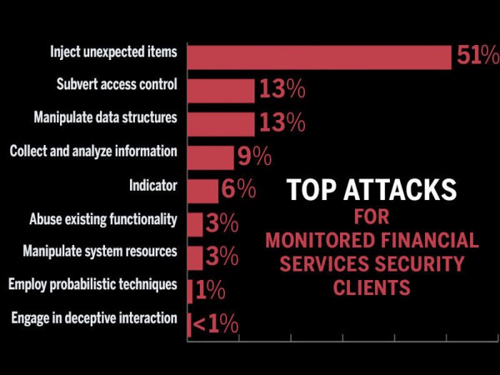
Attacks
injection vulnerabilities
cross-site scripting (XSS)
broken authentication and session management
insecure direct object references and security misconfiguration.

Slide 4
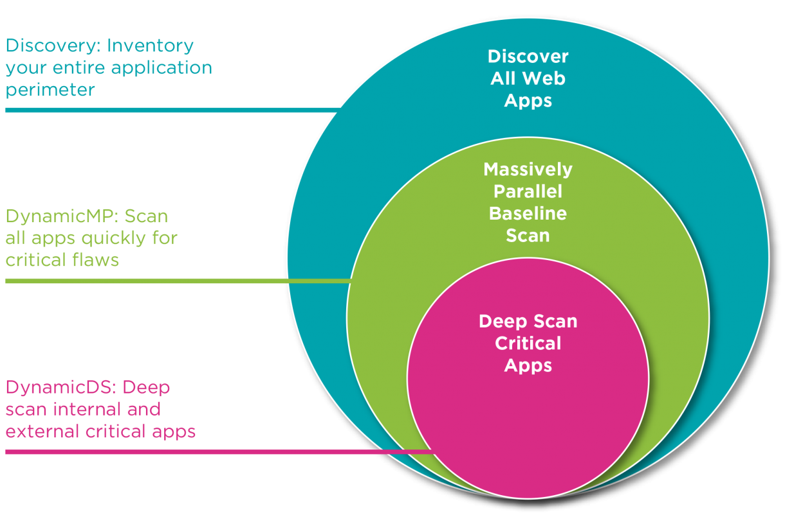
Counter measures
The most common hardware countermeasure is a router that can prevent the IP address of an individual computer from being directly visible on the Internet.
Other countermeasures include conventional firewalls, encryption/decryption programs , antivirus programs, spyware detection/removal programs and biometric authentication systems

